Slide 1
TEAM:28 ONLINE HOSTEL MANAGEMENT
GUIDED BY
Santhikumari G Madam
PRESENTED BY
Satyavathi P(15JN1A05A7)
Sivavani N(15JN1A05C0)
Nagavalli P(15JN1A05A0)
Nagambika N(15JN1A05B7)
Mahalakshmi D(15JN1A05A5)

Slide 2
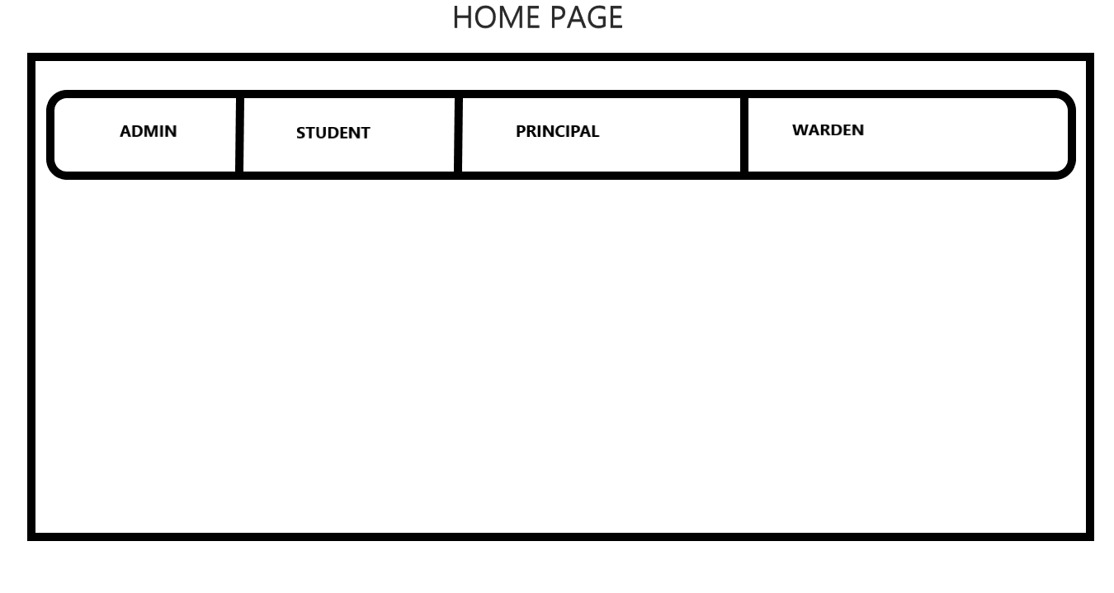
HOME PAGE

Slide 3
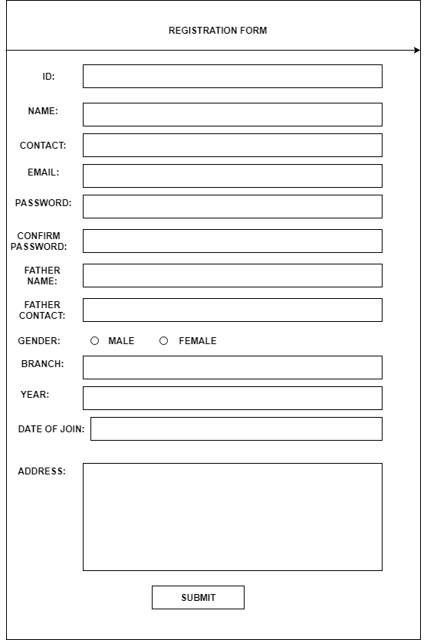
REGISTRATION PAGE

Slide 4
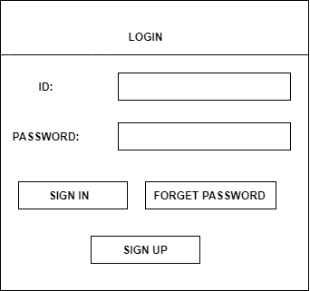
LOGIN PAGE

Slide 5
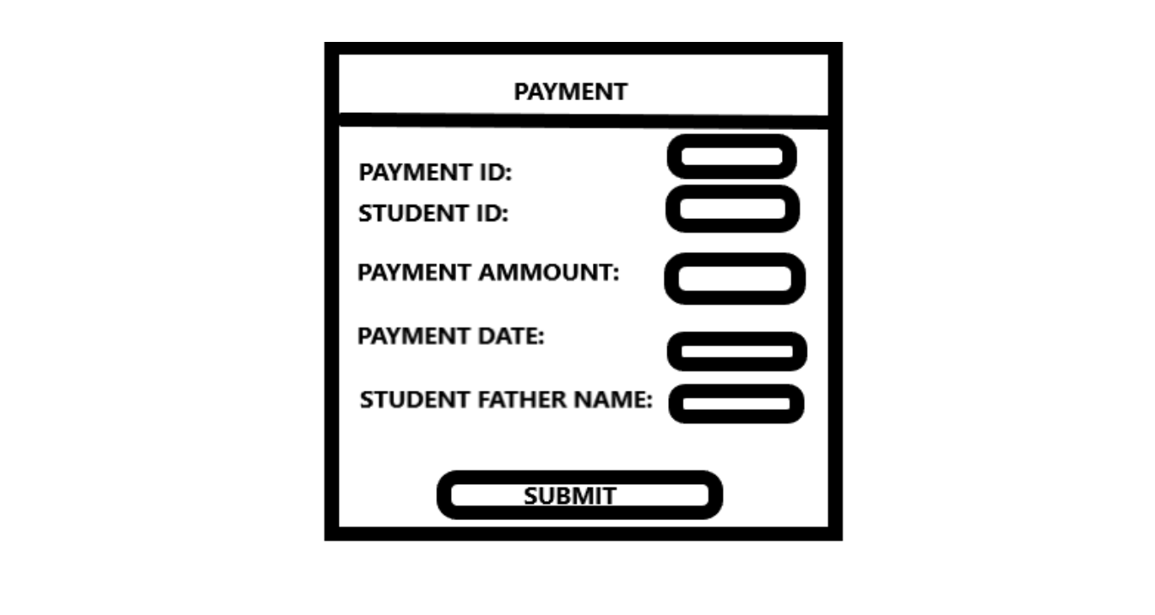
PAYMENT PAGE

Slide 6
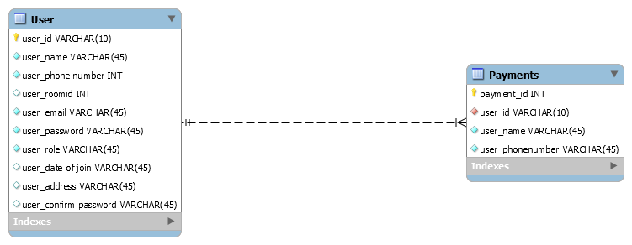
DATABASE SCHEMA

